Slide 1
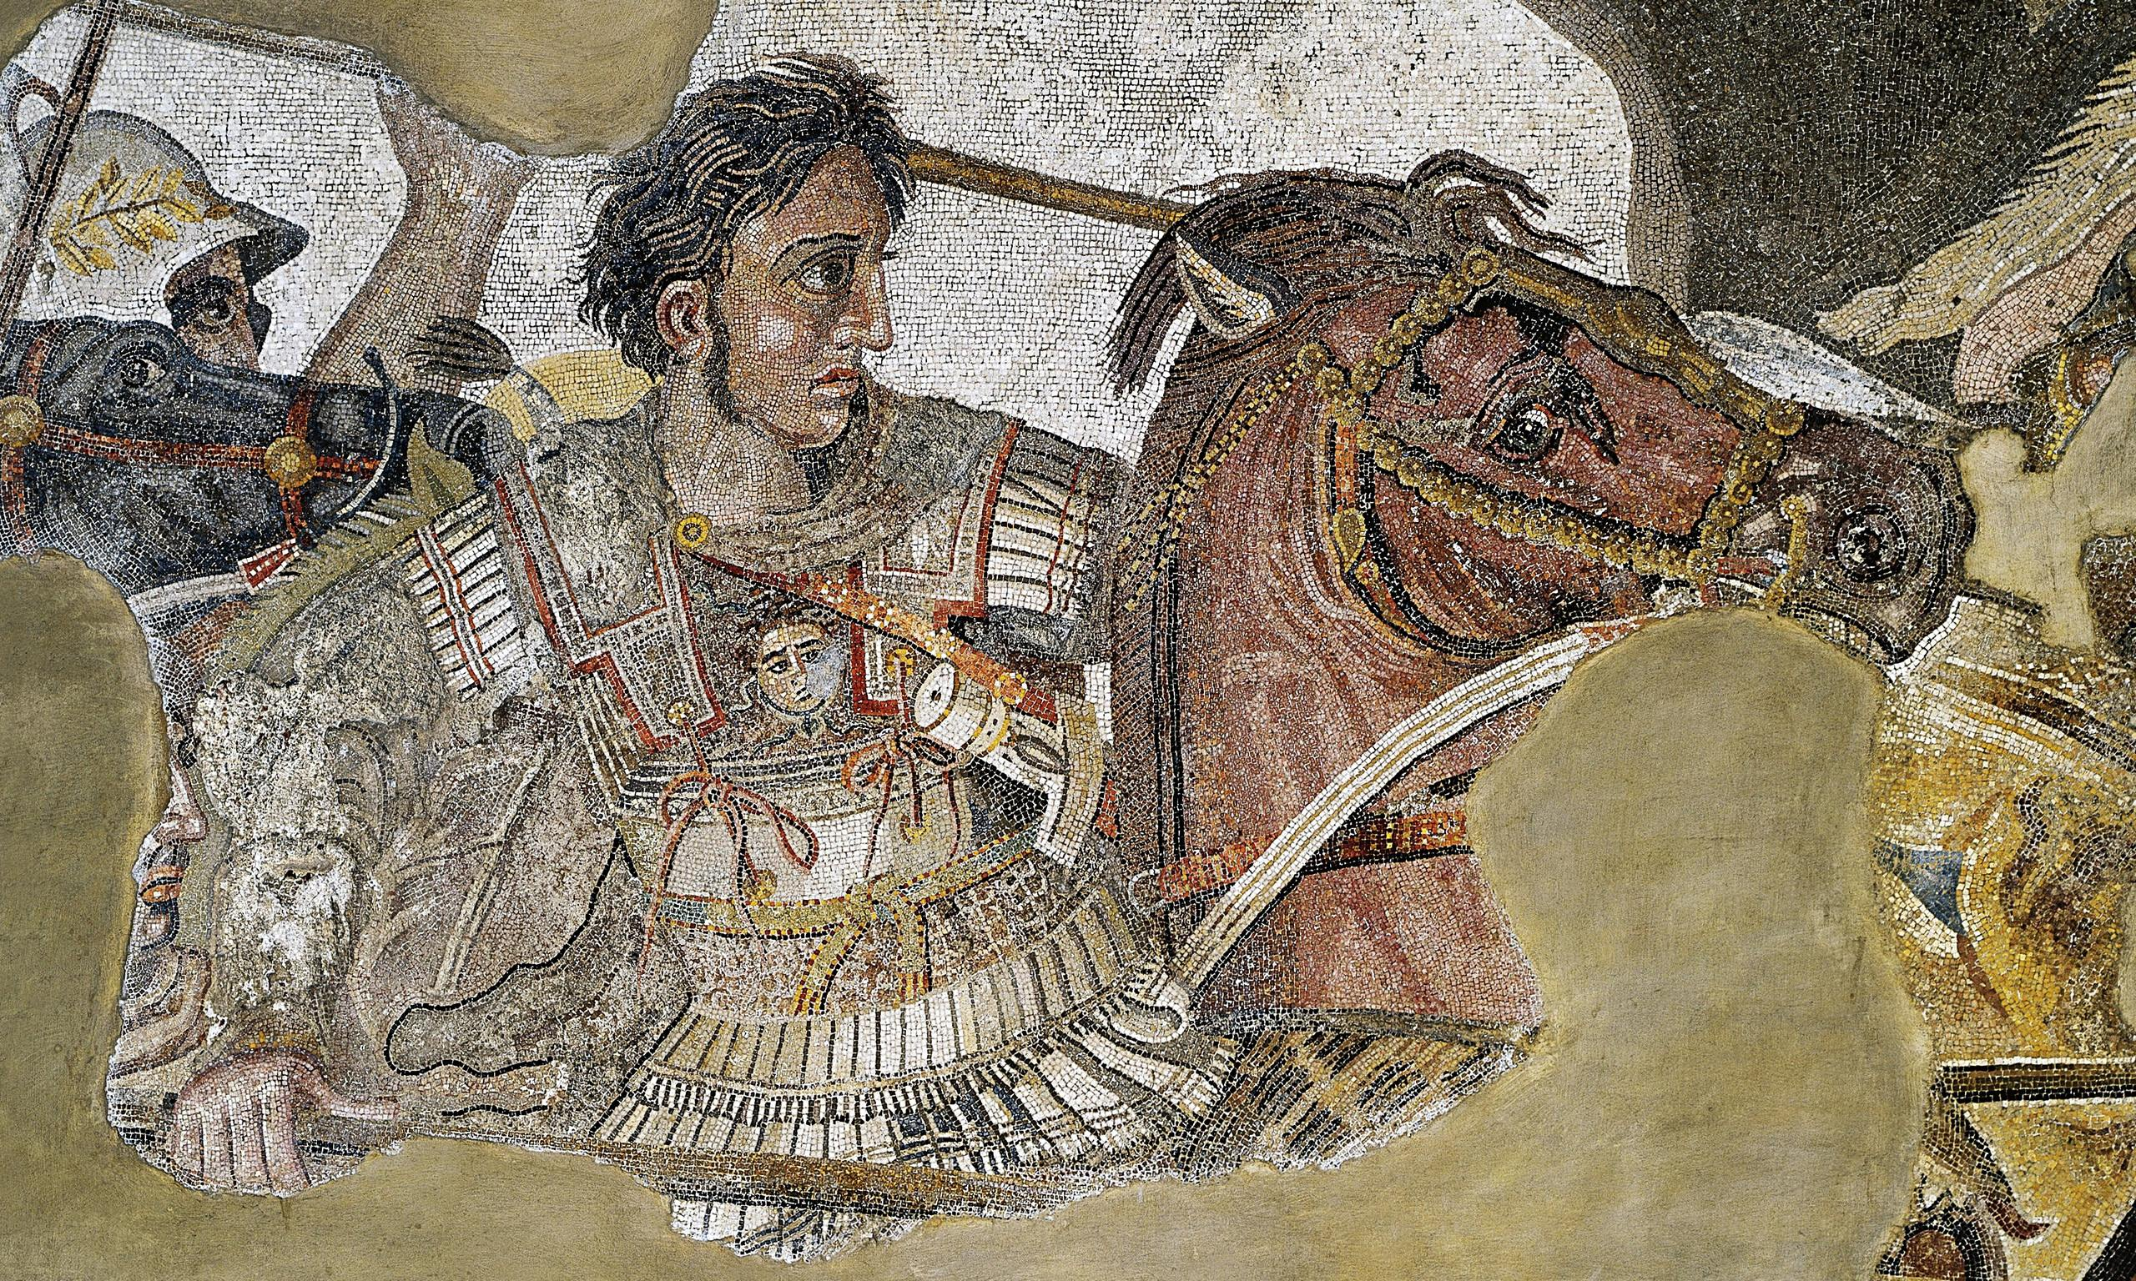
India and Hydaspes
Goal/s:
Describe how atg’s victory in india grew his empire
Week 10 Lesson 6 – unit 2
Ms Barrie

Slide 2
In 326 BCE, a young and ambitious Alexander the Great led his army against the mighty Indian king, Porus, on the banks of the Hydaspes River. This battle would be one of the most significant in Alexander's career - not only did he win, but he also conquered a vast new territory that would later become part of his ever-growing empire.

Slide 3
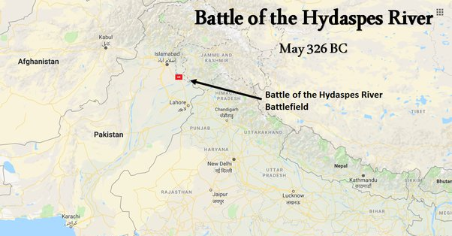

Slide 4
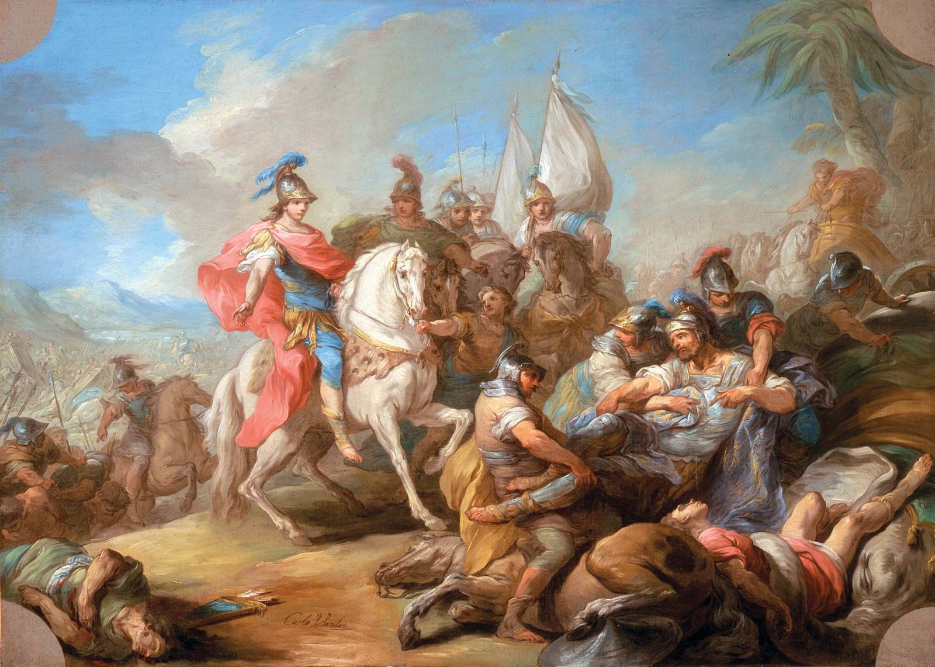
The Victory of Alexander over Porus
The Victory of Alexander over Porus, oil on canvas by Charles-André Van Loo, c. 1738, in the Los Angeles County Museum of Art, Los Angeles, California. 65.73 × 91.44 cm.

Slide 5
ACTIVITY – Battle of Hydaspes
Watch the following documentary about the Battle of Hydaspes:
https://www.youtube.com/watch?v=NxUXkhEoznQ&ab_channel=KingsandGenerals
Take notes on key people, ideas, and events
People | Ideas | Events

Slide 6
ACTIVITY – Source Analysis
Read the sources. Highlight for key words.
Edit and Complete the source questions.

